Slide 1
Data Mining : Implementations
By
Prof.Dr. O.P.Vyas
IIIT- A

Slide 2
D.M.W.
Data Mining
  Association Rule Mining: Apriori Algorithm
  Issues in DM : User-Centric Vs Procedure centric
    Utility Mining issues
    Rare item Problem:Single MinSup problem
  Classification & Predictive mechanism
    Classification & Business Intelligence
    Predictive Accuracy and various classifier accuracies
    Developing BI Solutions and Classification approach
  B.I. : Clustering Analysis
Social Network Analysis & Data Mining

Slide 3
Clustering
Imagine that you are the Director of Customer Relationships at AllElectronics, and you have 05 Managers working for you.
You have customer database which you would like to group all the customers into 05 groups so that each group can be assigned to a different manager.
Strategically you would like that the customers in each group are as similar as possible.
Moreover, two given customers having very different business patterns should not be placed in the same group.
Unlike in Classification, the class label of each customer is unknown.
You want to identify common features shared by the customers and thus has to have similarity and dissimilarity metrics discovered

Slide 4
Clustering is the process of grouping a set of data objects into multiple groups such that
Objects within the clusters have high similarity but are very dissimilar to objects in the other clusters
Given a large number of customers in a database with many features associated to each one of them Ex. Age, Gender, Monthly buying, Type of purchases (Sports, Cosmetics, FMCG, Payment options- Cards/Netbanking, ), with no pre-defined criterion for group but rather to decide the similarity metrics is also known as Unsupervised Learning

Slide 5
What is Cluster Analysis?
Cluster: a collection of data objects
  Similar to one another within the same cluster
  Dissimilar to the objects in other clusters
Cluster analysis
  The process of grouping a set of data objects into clusters
Clustering is unsupervised classification: no predefined classes
Clustering is similar to classification but the groups are not predefined in the clustering.
Typical applications
  As a stand-alone tool to get insight into data distribution
  As a preprocessing step for other algorithms

Slide 6
Clustering
What is a good Clustering ?
Similarity / dissimilarity metrics for Clustering?
Major Clustering Approaches
  Partitioning methods
  Hierarchical methods
  Density based methods
Outlier Analysis
    What is outlier ?
    Why & How ?

Slide 7
Density based clustering
We can model clusters as dense regions in the data space, separated by sparse regions
Partitioning & Hierarchical methods are designed to find spherical shaped clusters but they have difficulty finding clusters of arbitrary shape such as “S” shape and oval clusters.

Slide 8
Density-Based Clustering Methods
The density of an object O can be measured by the number of objects close to O
Clustering based on density (local cluster criterion), such as density-connected points
Major features:
  Discover clusters of arbitrary shape
  Handle noise
  One scan
  Need density parameters as termination condition
Several interesting studies:
  DBSCAN: Ester, et al. (KDD’96)
  OPTICS: Ankerst, et al (SIGMOD’99).
  DENCLUE: Hinneburg & D. Keim (KDD’98)
  CLIQUE: Agrawal, et al. (SIGMOD’98)

Slide 9
DBSCAN:
Relies on a density-based notion of cluster: A cluster is defined as a maximal set of density-connected points
Discovers clusters of arbitrary shape in spatial databases with noise
Outlier
Border
Eps = 1cm
MinPts = 5
Core

Slide 10
DBSCAN: Density Based Spatial Clustering of Applications with Noise
Directly density reachable
Density reachable
DBSCAN uses two parameters
  User specified Eps and MinPts are used to specify the parameters for Clustering.
Further improvements : OPTICS
  Core distance, Reachability distance

Slide 11
Density-Based Clustering: Background
Two parameters:
  Eps: Maximum radius of the neighbourhood
  MinPts: Minimum number of points in an Eps-neighbourhood of that point
  It is used to determine whether the neighbourhood is dense or not.
N_{Eps}(p): {q belongs to D | dist(p,q) <= Eps}
Directly density-reachable: A point p is directly density-reachable from a point q wrt. Eps, MinPts if
  1) p belongs to N_{Eps}(q)
  2) core point condition:
  |N_{Eps} (q)| >= MinPts
p
MinPts = 5
Eps = 1 cm
q

Slide 12
Density-Based Clustering: Background (II)
Density-reachable:
  For a core object q and an object p, we say p is directly density reachable from q, if p is within Eps neighborhood of q.
  A point p is density-reachable from a point q wrt. Eps, MinPts if there is a chain of points p₁, …, p_{n}, p₁ = q, p_{n} = p such that p_{i+1} is directly density-reachable from p_{i}
Density-connected
  A point p is density-connected to a point q wrt. Eps, MinPts if there is a point o such that both, p and q are density-reachable from o wrt. Eps and MinPts.
p
p₁
q
p
q
o

Slide 13
DBSCAN: Algorithm
  Arbitrary select a point p
  Retrieve all points density-reachable from p wrt Eps and MinPts.
  If p is a core point, a cluster is formed.
  If p is a border point, no points are density-reachable from p and DBSCAN visits the next point of the database.
  Continue the process until all of the points have been processed.

Slide 14
DBSCAN
It grows clusters according to the density of neighborhood objects.
It has found major applications in Spatial database, with varying population.
Complexity
DBSCAN visits each point of the database, possibly multiple times (e.g., as candidates to different clusters).
For practical considerations, however, the time complexity is mostly governed by the number of getNeighbors queries.
The complexity of DBSCAN is o(n*n) where n is no. of data objects
but if
an indexing structure is used then it is O(logn), is obtained.

Slide 15
DBSCAN
Advantages
DBScan does not require you to know the number of clusters in the data a priori, as opposed to k-means.
DBScan can find arbitrarily shaped clusters. It can even find clusters completely surrounded by (but not connected to) a different cluster. Due to the MinPts parameter, the so-called single-link effect (different clusters being connected by a thin line of points) is reduced.
DBScan requires just two parameters and is mostly insensitive to the ordering of the points in the database. (Only points sitting on the edge of two different clusters might swap cluster membership if the ordering of the points is changed, and the cluster assignment is unique only up to isomorphism.)

Slide 16
Disadvantages
DBSCAN can only result in a good clustering as good as its distance measure is in the function getNeighbors(P,epsilon).
The most common distance metric used is the euclidean distance measure. Especially for high-dimensional data, this distance metric can be rendered almost useless.
DBScan does not respond well to data sets with varying densities (called hierarchical data sets).
DBSCAN is sensitive to the two parameters-Eps and Minpts.
  Change in Eps and Minpts may lead to very different clusterings.

Slide 17



DBSCAN: Sensitive to Parameters
Data Mining: Concepts and Techniques

Slide 18
DBSCAN Limitations & OPTICS
Although DBSCAN can cluster objects given parameters but it encumbers users with responsibility of selecting parameters values that will lead to the discovery of acceptable clusters.
Most algorithms are sensitive to these parameter values: Slightly different settings may lead to very different Clustering of same data sets.

Slide 19
OPTICS
OPTICS (ordering points to identify the clustering structure) is an algorithm for finding clusters in spatial data which addresses the problems of DBSCAN
Its basic idea is similar to DBSCAN, but it addresses one of DBSCAN's major weaknesses:
  the problem of detecting meaningful clusters in data of varying density.
In order to do so, the points of the database are (linearily) ordered such that points which are spatially closest become neighbors in the ordering.
Additionally, a special distance is stored for each point that represents the density that needs to be accepted for a cluster in order to have both points belong to the same cluster.

Slide 20
OPTICS: A Cluster-Ordering Method (1999)
OPTICS: Ordering Points To Identify the Clustering Structure
  Ankerst, Breunig, Kriegel, and Sander (SIGMOD’99)
  Produces a special order of the database wrt its density-based clustering structure
  This cluster-ordering contains info equiv to the density-based clusterings corresponding to a broad range of parameter settings
  Good for both automatic and interactive cluster analysis, including finding intrinsic clustering structure
  Can be represented graphically or using visualization techniques : DENDOGRAMS.
  Using a reachability-plot (a special kind of dendrogram), the hierarchical structure of the clusters can be obtained easily.
    It is a 2D plot, with the ordering of the points on the x-axis and the reachability distance on the y-axis. Since points belonging to a cluster have a low reachability distance to their nearest neighbor, the clusters show up as valleys in the reachability plot. The deeper the valley, the denser the cluster.

Slide 21
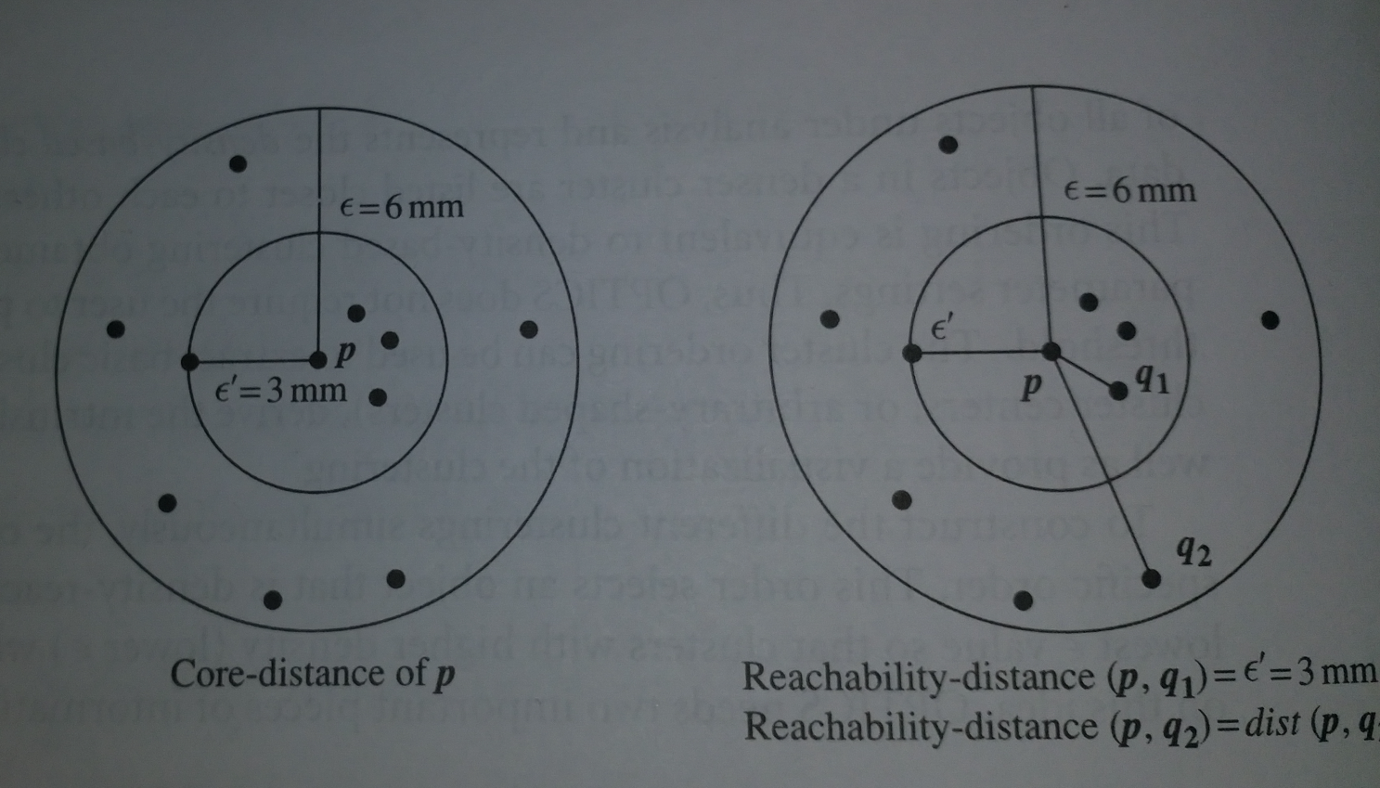
OPTICS
OPTICS needs two important information
Core Distance
If ε = 6 mm, MinPts = 5 then ε’ is distance between p & fourth closest data object from p, = 3 cm thus ε’ Core Distance
Reachability Distance to object p from q is the minimum radius value that makes p density reachable

Slide 22
OPTICS: Some Extension from DBSCAN
Index-based:
    k = number of dimensions
    N = 20
    p = 75%
    M = N(1-p) = 5
  Complexity: O(kN²)
Core Distance
Reachability Distance
D
p1
o
p2
o
Max (core-distance (o), d (o, p))
r(p1, o) = 2.8cm. r(p2,o) = 4cm
MinPts = 5
ε = 3 cm

Slide 23


Reachability-distance
undefined
‘
Cluster-order
of the objects

Slide 24


Regionalisation
Regionalisation, a prominent problem from social geography, could be solved by a density based clustering algorithm for grouping spatial objects.
A typical task is to find spatially compact and dense regions of arbitrary shape with a homogeneous internal distribution of social variables.

Slide 25
Density-Based Clustering: Applications in Regionalization
Grouping a set of homogeneous spatial units to compose a larger region can be useful for sampling procedures as well as many applications, e.g., direct mailing.
It would be helpful to have specific purpose regions, depending on the kind of homogeneity one is interested in.
In our research paper, we propose an algorithm combining the ‘spatial density’ clustering approach and a covariance-based method to inductively find spatially dense and non-spatially homogeneous clusters of arbitrary shape.
Data Mining: Concepts and Techniques

Slide 26
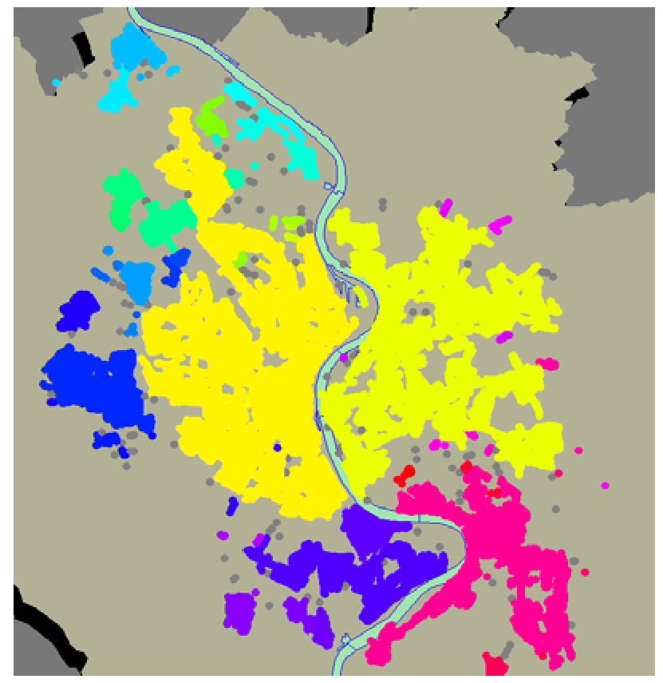
Clustering of Cologne City geographical region using DBSCAN

Slide 27
DENCLUE: using density functions
DENsity-based CLUstEring by Hinneburg & Keim (KDD’98)
Major features
  Solid mathematical foundation
  Good for data sets with large amounts of noise
  Allows a compact mathematical description of arbitrarily shaped clusters in high-dimensional data sets
  Significant faster than existing algorithm (faster than DBSCAN by a factor of up to 45)
  But needs a large number of parameters

Slide 28
Denclue: Technical Essence
Uses grid cells but only keeps information about grid cells that do actually contain data points and manages these cells in a tree-based access structure.
Influence function: describes the impact of a data point within its neighborhood.
Overall density of the data space can be calculated as the sum of the influence function of all data points.
Clusters can be determined mathematically by identifying density attractors.
Density attractors are local maximal of the overall density function.

Slide 29
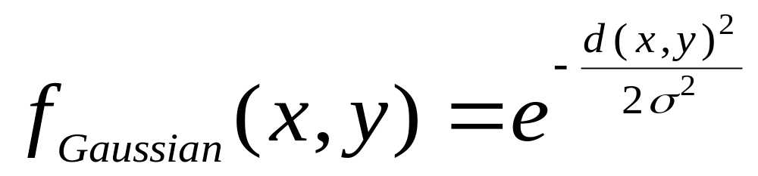
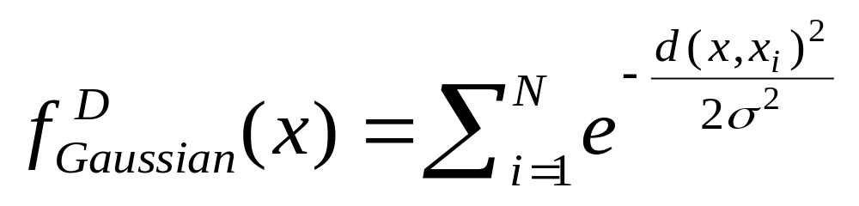

Gradient: The steepness of a slope
Example

Slide 30



Density Attractor

Slide 31

Center-Defined and Arbitrary

Slide 32
Chapter 8. Cluster Analysis
What is Cluster Analysis?
Types of Data in Cluster Analysis
A Categorization of Major Clustering Methods
Partitioning Methods
Hierarchical Methods
Density-Based Methods
Grid-Based Methods
Model-Based Clustering Methods
Outlier Analysis
Summary

Slide 33
Grid-Based Clustering Method
Using multi-resolution grid data structure
Several interesting methods
  STING (a STatistical INformation Grid approach) by Wang, Yang and Muntz (1997)
  WaveCluster by Sheikholeslami, Chatterjee, and Zhang (VLDB’98)
    A multi-resolution clustering approach using wavelet method
  CLIQUE: Agrawal, et al. (SIGMOD’98)

Slide 34
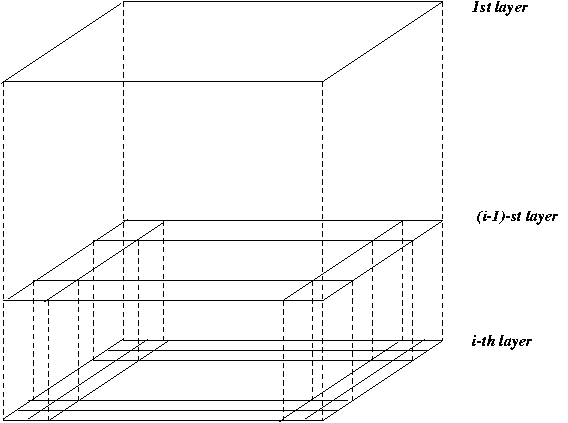
STING: A Statistical Information Grid Approach
Wang, Yang and Muntz (VLDB’97)
The spatial area area is divided into rectangular cells
There are several levels of cells corresponding to different levels of resolution

Slide 35
STING: A Statistical Information Grid Approach (2)
  Each cell at a high level is partitioned into a number of smaller cells in the next lower level
  Statistical info of each cell is calculated and stored beforehand and is used to answer queries
  Parameters of higher level cells can be easily calculated from parameters of lower level cell
    count, mean, s, min, max
    type of distribution—normal, uniform, etc.
  Use a top-down approach to answer spatial data queries
  Start from a pre-selected layer—typically with a small number of cells
  For each cell in the current level compute the confidence interval

Slide 36
STING: A Statistical Information Grid Approach (3)
  Remove the irrelevant cells from further consideration
  When finish examining the current layer, proceed to the next lower level
  Repeat this process until the bottom layer is reached
  Advantages:
    Query-independent, easy to parallelize, incremental update
    O(K), where K is the number of grid cells at the lowest level
  Disadvantages:
    All the cluster boundaries are either horizontal or vertical, and no diagonal boundary is detected

Slide 37
WaveCluster (1998)
Sheikholeslami, Chatterjee, and Zhang (VLDB’98)
A multi-resolution clustering approach which applies wavelet transform to the feature space
  A wavelet transform is a signal processing technique that decomposes a signal into different frequency sub-band.
Both grid-based and density-based
Input parameters:
  # of grid cells for each dimension
  the wavelet, and the # of applications of wavelet transform.

Slide 38
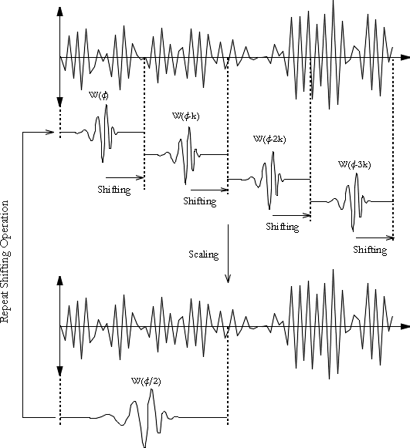
What is Wavelet (1)?

Slide 39
WaveCluster (1998)
How to apply wavelet transform to find clusters
  Summaries the data by imposing a multidimensional grid structure onto data space
  These multidimensional spatial data objects are represented in a n-dimensional feature space
  Apply wavelet transform on feature space to find the dense regions in the feature space
  Apply wavelet transform multiple times which result in clusters at different scales from fine to coarse

Slide 40


What Is Wavelet (2)?

Slide 41

Quantization

Slide 42

Transformation

Slide 43
WaveCluster (1998)
Why is wavelet transformation useful for clustering
  Unsupervised clustering
  It uses hat-shape filters to emphasize region where points cluster, but simultaneously to suppress weaker information in their boundary
  Effective removal of outliers
  Multi-resolution
  Cost efficiency
Major features:
  Complexity O(N)
  Detect arbitrary shaped clusters at different scales
  Not sensitive to noise, not sensitive to input order
  Only applicable to low dimensional data

Slide 44
CLIQUE (Clustering In QUEst)
Agrawal, Gehrke, Gunopulos, Raghavan (SIGMOD’98).
Automatically identifying subspaces of a high dimensional data space that allow better clustering than original space
CLIQUE can be considered as both density-based and grid-based
  It partitions each dimension into the same number of equal length interval
  It partitions an m-dimensional data space into non-overlapping rectangular units
  A unit is dense if the fraction of total data points contained in the unit exceeds the input model parameter
  A cluster is a maximal set of connected dense units within a subspace

Slide 45
CLIQUE: The Major Steps
Partition the data space and find the number of points that lie inside each cell of the partition.
Identify the subspaces that contain clusters using the Apriori principle
Identify clusters:
  Determine dense units in all subspaces of interests
  Determine connected dense units in all subspaces of interests.
Generate minimal description for the clusters
  Determine maximal regions that cover a cluster of connected dense units for each cluster
  Determination of minimal cover for each cluster

Slide 46
Salary (10,000)
Vacation(week)
7
7
6
6
5
5
4
4
3
3
2
2
1
1
0
age
0
age
20
30
40
50
60
20
30
40
50
60
τ = 3
Vacation
Salary
30
50
age

Slide 47
Strength and Weakness of CLIQUE
Strength
  It automatically finds subspaces of the highest dimensionality such that high density clusters exist in those subspaces
  It is insensitive to the order of records in input and does not presume some canonical data distribution
  It scales linearly with the size of input and has good scalability as the number of dimensions in the data increases
Weakness
  The accuracy of the clustering result may be degraded at the expense of simplicity of the method

Slide 48
Cluster Analysis
What is Cluster Analysis?
Types of Data in Cluster Analysis
A Categorization of Major Clustering Methods
Partitioning Methods
Hierarchical Methods
Density-Based Methods
Grid-Based Methods
Model-Based Clustering Methods
Outlier Analysis
Summary

Slide 49
Model-Based Clustering Methods
Attempt to optimize the fit between the data and some mathematical model
Statistical and AI approach
  Conceptual clustering
    A form of clustering in machine learning
    Produces a classification scheme for a set of unlabeled objects
    Finds characteristic description for each concept (class)
  COBWEB (Fisher’87)
    A popular a simple method of incremental conceptual learning
    Creates a hierarchical clustering in the form of a classification tree
    Each node refers to a concept and contains a probabilistic description of that concept

Slide 50

COBWEB Clustering Method
A classification tree

Slide 51
More on Statistical-Based Clustering
Limitations of COBWEB
  The assumption that the attributes are independent of each other is often too strong because correlation may exist
  Not suitable for clustering large database data – skewed tree and expensive probability distributions
CLASSIT
  an extension of COBWEB for incremental clustering of continuous data
  suffers similar problems as COBWEB
AutoClass (Cheeseman and Stutz, 1996)
  Uses Bayesian statistical analysis to estimate the number of clusters
  Popular in industry

Slide 52
Other Model-Based Clustering Methods
Neural network approaches
  Represent each cluster as an exemplar, acting as a “prototype” of the cluster
  New objects are distributed to the cluster whose exemplar is the most similar according to some dostance measure
Competitive learning
  Involves a hierarchical architecture of several units (neurons)
  Neurons compete in a “winner-takes-all” fashion for the object currently being presented

Slide 53
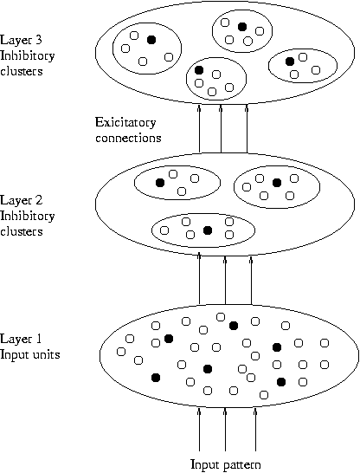
Model-Based Clustering Methods

Slide 54
Self-organizing feature maps (SOMs)
Clustering is also performed by having several units competing for the current object
The unit whose weight vector is closest to the current object wins
The winner and its neighbors learn by having their weights adjusted
SOMs are believed to resemble processing that can occur in the brain
Useful for visualizing high-dimensional data in 2- or 3-D space

Slide 55
What Is Outlier Discovery?
What are outliers?
  The set of objects are considerably dissimilar from the remainder of the data
  Example: Sports: Michael Jordon, Sachin Tendulkar, ...
Problem
  Why: Somebody’s noise can be Alarm for Other
  How: Find top n outlier points
Applications:
  Anomaly Detection:
    Credit card fraud detection
    Telecom fraud detection
    Network Fault occurrences
  Medical analysis
  Customer segmentation

Slide 56
Outlier Mining
Given a set of n data points or objects, and k, the expected number of outliers,
Find the top k objects that are considerably dissimilar, exceptional, or inconsistent with respect to the remaining data.
The outlier mining problem can be viewed as two subproblems;
  Define what data can be considered as inconsistent in a given data set, and
  Find an efficient method to mine the outliers so defined

Slide 57

Outlier Discovery: Statistical Approaches
Assume a model underlying distribution that generates data set (e.g. normal distribution)
Use discordancy tests depending on
  data distribution
  distribution parameter (e.g., mean, variance)
  number of expected outliers
Drawbacks
  most tests are for single attribute
  In many cases, data distribution may not be known

Slide 58
Outlier Discovery: Distance-Based Approach
Introduced to counter the main limitations imposed by statistical methods
  We need multi-dimensional analysis without knowing data distribution.
Distance-based outlier: A DB(p, D)-outlier is an object O in a dataset T such that at least a fraction p of the objects in T lies at a distance greater than D from O
Algorithms for mining distance-based outliers
  Index-based algorithm
  Nested-loop algorithm
  Cell-based algorithm

Slide 59
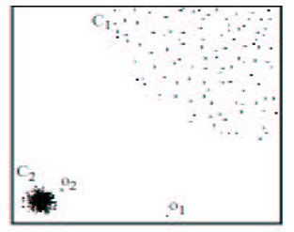
Density-Based Local Outlier Detection
Distance-based outlier detection is based on global distance distribution
It encounters difficulties to identify outliers if data is not uniformly distributed
Ex. C₁ contains 400 loosely distributed points, C₂ has 100 tightly condensed points, 2 outlier points o₁, o₂
Distance-based method cannot identify o₂ as an outlier
Need the concept of local outlier
Local outlier factor (LOF)
  Assume outlier is not crisp
  Each point has a LOF
Data Mining: Concepts and Techniques

Slide 60
Outlier Discovery: Deviation-Based Approach
Identifies outliers by examining the main characteristics of objects in a group
Objects that “deviate” from this description are considered outliers
Sequential exception technique
  simulates the way in which humans can distinguish unusual objects from among a series of supposedly like objects
OLAP data cube technique
  uses data cubes to identify regions of anomalies in large multidimensional data
Data Mining: Concepts and Techniques

Slide 61
Outlier Discovery: Deviation-Based Approach
Identifies outliers by examining the main characteristics of objects in a group
Objects that “deviate” from this description are considered outliers
sequential exception technique
  simulates the way in which humans can distinguish unusual objects from among a series of supposedly like objects
OLAP data cube technique
  uses data cubes to identify regions of anomalies in large multidimensional data

Slide 62
Cluster Analysis
What is Cluster Analysis?
Types of Data in Cluster Analysis
A Categorization of Major Clustering Methods
Partitioning Methods
Hierarchical Methods
Density-Based Methods
Grid-Based Methods
Model-Based Clustering Methods
Outlier Analysis
Summary

Slide 63
Cluster Analysis
What is Cluster Analysis?
Types of Data in Cluster Analysis
A Categorization of Major Clustering Methods
Partitioning Methods
Hierarchical Methods
Density-Based Methods
Grid-Based Methods
Model-Based Clustering Methods
Outlier Analysis
Summary

Slide 64
Problems and Challenges
Considerable progress has been made in scalable clustering methods
  Partitioning: k-means, k-medoids, CLARANS
  Hierarchical: BIRCH, CURE
  Density-based: DBSCAN, CLIQUE, OPTICS
  Grid-based: STING, WaveCluster
  Model-based: Autoclass, Denclue, Cobweb
Current clustering techniques do not address all the requirements adequately
Constraint-based clustering analysis: Constraints exist in data space (bridges and highways) or in user queries

Slide 65
Constraint-Based Clustering Analysis
Clustering analysis: less parameters but more user-desired constraints, e.g., an ATM allocation problem

Slide 66
Summary
Cluster analysis groups objects based on their similarity and has wide applications
Measure of similarity can be computed for various types of data
Clustering algorithms can be categorized into partitioning methods, hierarchical methods, density-based methods, grid-based methods, and model-based methods
Outlier detection and analysis are very useful for fraud detection, etc. and can be performed by statistical, distance-based or deviation-based approaches
There are still lots of research issues on cluster analysis, such as constraint-based clustering

Slide 67
Bibliography
J. Han and M. Kamber. Data Mining – Concepts and Techniques. 2001. Morgan Kaufmann.
M. Kantardzic. Data Mining – Concepts, Models, Methods, and Algorithms. 2003. IEEE.
M. H. Dunham. Data Mining – Introductory and Advanced Topics.
I.H. Witten and E. Frank. Data Mining – Practical Machine Learning Tools and Techniques with Java Implementations. 2000. Morgan Kaufmann.
Ranjana Vyas- Ph.D. Thesis “ Exploring some data mining techniques for DSS through efficient Knowledge Management” 2008.
Fall 2003
CSE 494 by H. Liu

